Slide 1

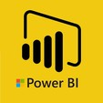
Hii,
Iam Siddhika
Welcome to Power BI Series
Part -79

Slide 2



I’m very excited to dive into this with you all!
Are you ready to enhance your data visualization skills?
We focus only few visuals...
Today Content
VISUALIZING DATA
CUSTOM VISUALS IN POWER BI
WORD CLOUD SCROLLER
SUNBURST

Slide 3

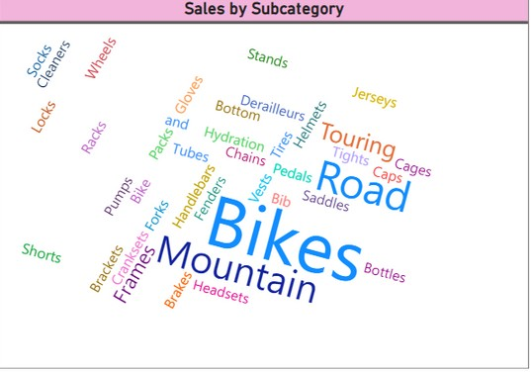
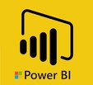
WORD CLOUD
A Word Cloud visual displays the most frequently occurring words in a dataset, with the size of each word representing its frequency or importance.
got it ..
When to Use:
To visualize text data.
To identify prominent themes or keywords.
Purpose:To convey the
quickly most
important or frequently mentioned terms in a text dataset.

Slide 4

SCROLLER
Hey guys
A Scroller visual displays scrolling text, often used for news tickers or to highlight important metrics dynamically.
When to Use:
To highlight key metrics or announcements in a scrolling format.
To display continuously updating information, such as stock prices or social media mentions.
Purpose:To keep viewers informed of key metrics or messages without taking up much screen space.
actually the
words are
scrolling...
you can try
once

Slide 5

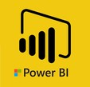
SUNBURST
check next
A Sunburst
visual displays hierarchical data using
slide to see
concentric circles. Each level of the hierarchy is represented by one ring or circle with the innermost circle being the top of the hierarchy.
When to Use:
To visualize hierarchical data, such as organizational structures or product categories.
To show the relationship between different levels of data.
Purpose:To provide an interactive and visual representation of hierarchical data, making it easier to understand the structure and distribution.
the visual..

Slide 6
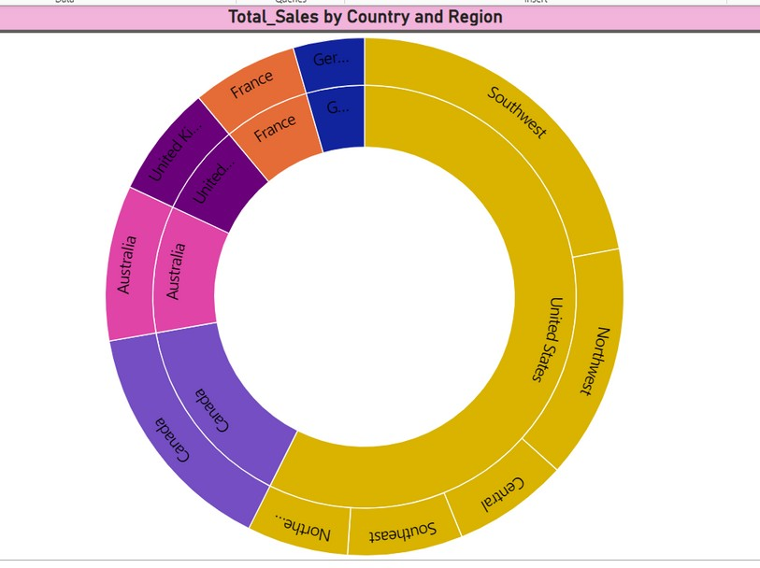
once go and try guys... lets see few more custom visuals in next part..

Slide 7


Thank you for joining me today to learn about Part -79 of Power BI!
Remember, Effective data visualization is crucial for turning data into meaningful insights and compelling narratives with Power BI.
Stay tuned for more insights and tips on Power BI in our next Series.
Follow

